Slide 1






PRESENTATION 2026
Student Name
Student Email
Barad Vaidehiba Jaydipsinh
jaydipsinhbarad459@gmail.com
& vaidehibabarad459@gmail.com
Mentor Name
Umamaheshwari mam

Slide 2

Outline
Abstract of the Project
Problem Statement
Proposed Solution
System Architecture
Live Demo of the Project
Embedded Video of Project
Conclusion
Future Scope

Slide 3

Abstract
Purpose : To study house price trends in India And affordability , growth drivers.
Tools : Excel , Ai forecasting models.
Outcomes : Dashboards , affordability indices , predictive insights.
Highlight : Unique integration of affordability + predictive analysis.

Slide 4

Problem Statement
Rising house price – affordability challenges for middle-income buyers.
Lack of integrated dashboards combining affordability , growth trends , and predictive analysis .
Target users : policymakers , investors , buyers.
Scope : focus on urban cities ( Delhi-NCR , Bengaluru , Hyderabad , Pune , Mumbai) .

Slide 5

Proposed Solution
Build a Data-Driven dashboard.
Integrate house price dataset, affordability indices, and AI – based predictive models.
benefits : clear city-wise insights , affordability gap analysis , future forecasts.
Innovation : Combines multiple Tools ( Excel , Python, AI)

Slide 6
System Architecture
Data Input / Source
Processing / Analysis
House price dataset containing features like bedrooms, bathrooms, area, and price.
Data cleaning and analysis is done using Excel, including pivot tables and charts.
AI / Tool Integration
Output / Dashboard
AI chatbot is created using Microsoft Copilot Studio to answer user queries.
Excel dashboard and chatbot responses showing insights and answers.

Slide 7
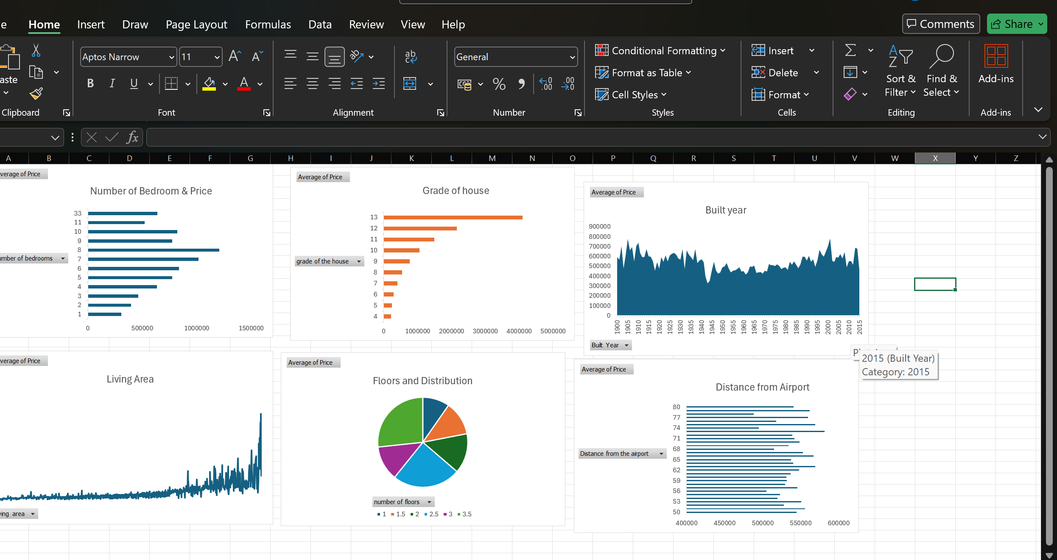
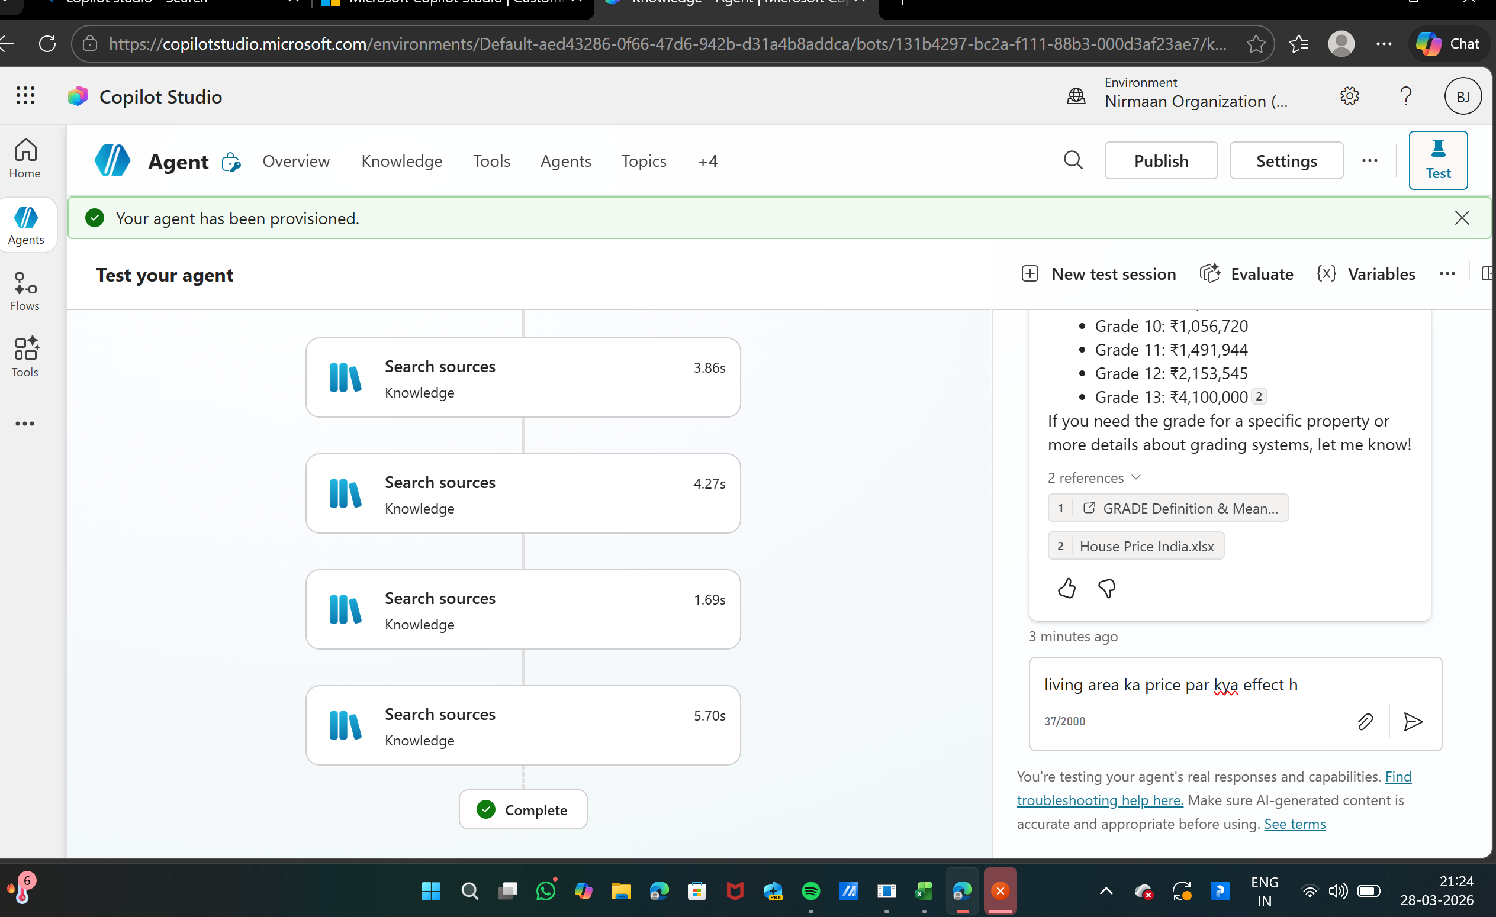
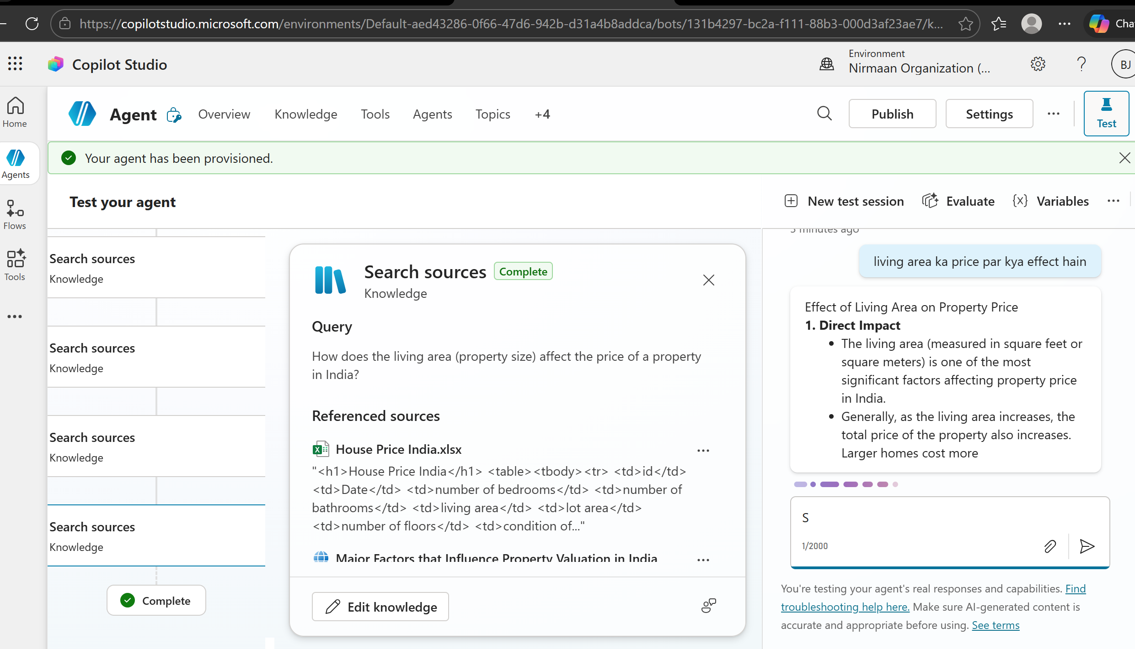
Live Demo of Project
Here's the list of some demo screenshots / features of the project:
Demo 1
Price Trends dashboard
Demo 2
Affordability Index
Demo 3
Predictive Analysis
Year – on Year growth
Across cities.
Income vs. house
Price Comparison.
AI – Based forecasts of
House price growth.

Slide 8
Video of Project Demo
[https://drive.google.com/file/d/1uVIuX3RPUg7a4M20ZWH7UiG2nJvTsYYB/view?usp=sharing – My vid link
▶
[My demo video is completed and uploaded to ppt in link type go to link and watch ,
understand my project House price in India]

Slide 9

Conclusion
The Project successfully integrates multiple tools to provide actionable insights into house price trends in India.
Objectives of affordability analysis and predictive modeling were achieved . This adds value to policymakers , investors , and buyers. Adds value by combining multiple tools into one integrated solution.
CONCLUSION

Slide 10

Future Scope
Expand datasets to include rental markets.
Integrate real – time APIs for dynamic updates.
Enhance predictive models with machine learning.
Scale dashboards for broader geographic coverage.

Slide 11
Thank You
AICW Fellowship | Student Project Presentation 2026
LinkedIn | Edunet Foundation

